Slide 1
ZOMATO ANALYSIS
PRESENTING BY GROUP - 2
MADAGAM NIHARIKA
RASIKA SUNIL ADHAV
M.USHA RANI
SAMIR KU. BARIK
AKSHAY SINGH
ANNAPURNA PATIL
SHRUSTI SANJIV KOTABAGI

Slide 2
AGENDA
INTRODUCTION
DATASET OVERVIEW
BUSSINESS SUMMARY
OBJECTIVES
BUSINESS IMPACT AND SCOPE
WHAT WE HAVE LEARNED IN THIS PROJECT?
KEY INSIGHTS
RECOMMENDATIONS
CONCLUSION

Slide 3
INTRODUCTION
Zomato is a global restaurant discovery and food delivery platform that connects customers with a wide range of restaurants .Launched in ‘2008’
Zomato has grown to operate in multiple countries , offering services such as restaurant listings , online reservations and food delivery
It provides detailed information on restaurants , including menus , customer reviews , ratings , pricing , and location details . Users can explore various cuisines , make table reservations , and order food for delivery.
This platform servers as a bridge between customers and restaurants , helping restaurants reach a larger audience and providing customers with a convenient way to explore dining options.

Slide 4
DATASET OVERVIEW
The dataset used in this analysis is a collection of information from Zomato’s restaurant listings , including a variety of attributes such as restaurant names , locations , cuisines , ratings , pricing.
It aims to provide insights into restaurant performance , customer perferences and market trends . By analyzing this data we can uncover patterns and make data-driven recommendations for both Zomato and restaurants listed on its platform.
It contains records and columns , covering various aspects like restaurant name , city , locality , cuisine types , average ratings , number of votes , price range and other essential details.
The data spans from [start date] to [end date] , offering a historical perspective on restaurant growth , customer preferences , and market dynamics over time.

Slide 5
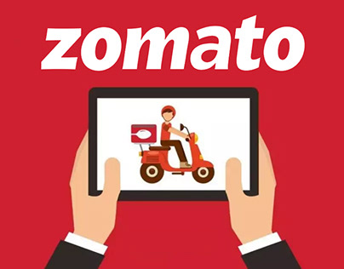
BUSINESS SUMMARY
Customer preferences identify patterns such as popular cuisines , avg rating , price these insights help restaurants tailor their offerings to align with market demands and enhance customer dining experience
Restaurant landscape showcase wide variety of types ranging from casual dining to fine dining , fast food , cafes
Market positioning: The Zomato plays a vital role in connecting restaurants with customers , it reveals how zomato platform gaining visibility and reaching a broader customer base and highlights competitive pricing strategies and customer reviews
Data-driven: The dataset extensive information including restaurant ratings , locations , cuisines , pricing provides valuable insights for restaurants and stakeholders

Slide 6
OBJECTIVES
IDENTIFY MARKET PREFERENCES
Analyze restaurant data to uncover customer preferences across different cities , helping to identify which cuisines and dining options are most popular.
EVALUATE PRICING STRATEGIES
Examine the cost distribution of restaurants to understand pricing trends and identify optimal price points for various market segments.
ASSESS CUSTOMER RATINGS
Investigate the relationships between customer ratings and restaurant features such as cuisine type , location , and dining options to determine key factors driving customer satisfaction.
UNDERSTAND REGIONAL TRENDS
Explore city-specific insights to highlight differences in customer behavior and preferences , providing a foundation for location-based marketing and business strategies.
PROVIDE ACTIONABLE INSIGHTS
Use data-driven analysis to offer practical recommendations that can enhance restaurant performance and improve customer experiences.

Slide 7
BUSINESS IMPACT AND SCOPE
MARKET POSITIONING : Zomato’s data provides restaurants with a competitive edge by revealing market trends and customer preferences.
STRATEGIC DECISION-MAKING : Insights into pricing , location , and customer behaviour help restaurants make informed decisions to enhance their market presence.
CUSTOMER ENGAGEMENT: By understanding customer preferences , restaurants can tailor their offerings , leading to improved customer satisfaction and loyalty.
SCOPE OF GROWTH: The analysis uncovers potential areas for market expansion and service improvement , aiding in the strategic planning for both Zomato and the restaurants on its platform.
The insights derived from the data have a significant impact on business strategies , enabling restaurants to optimize pricing , enhance customer engagement , and identify areas for market expansion.
“Zomato serves as a critical resource for restaurants , offerings valuable data-driven guidance to navigate the competitive landscape and meet evolving customer demands.”

Slide 8
TOOLS AND TECHNIQUES OVERVIEW
1.MySQL: Data Structuring and Analysis Used to build essential data tables like the country map and calendar . Enabled complex data segmentation, such as classifying restaurants by cost and services . Aggregated data (e.g., restaurants by city, cuisine) for clear KPI extraction . Prepared a clean and structured dataset for visualization tools.
2. Excel: Data Cleaning and Basic Visualizations Performed initial data cleaning (e.g., removing duplicates, handling missing values).Created preliminary charts (e.g., top cuisines, price ranges) for quick insights . Helped identify key trends to guide deeper analysis . Set a foundational understanding of dataset patterns and relationships.
3. Tableau: Interactive Dashboard Creation Integrated data from MySQL and Excel for comprehensive visualization . Built interactive dashboards for KPIs like customer ratings and location impact . Allowed dynamic exploration of data trends and insights . Enhanced data storytelling with visual filters and drill-downs.
4. Power BI: Advanced Analytics and Reporting Modeled data for detailed KPI analysis and advanced reporting . Created visually engaging reports (e.g., online delivery analysis, location impact).Used diverse visual elements to present complex data insights clearly . Enabled deeper analytical views, supporting better decision-making.

Slide 9
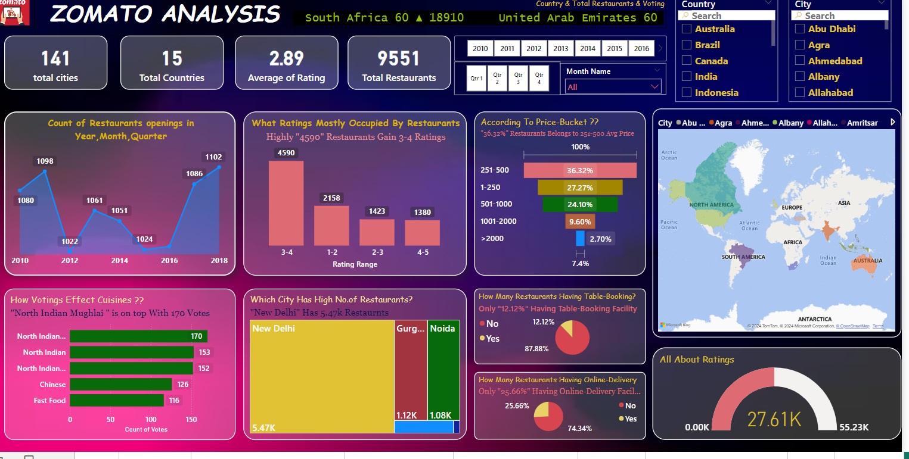
POWER-BI DASHBOARD

Slide 10
WHAT WE HAVE LEARNED IN THIS PROJECT ?
POPULAR CUISINES DRIVE RATINGS
Cuisines consistently received higher ratings , indicating that offering popular food options can enhance customer satisfaction.
CITY-BASED DIVERSITY
Cities with a higher concentration of restaurants show a diverse range of dining experiences , but also face higher competition , requiring strategic differentiation.
PRICING SENSITIVITY MATTERS
Customers in different regions exhibit varying levels of price sensitivity , suggesting that tailored pricing strategies can be more effective in targeting specific market segments.
IMPORTANCE OF RATINGS
High customer ratings are crucial for restaurant success , as they are often linked with better visibility and customer trust , influencing dining choices.
DATA TOOLS PROVIDE CLARITY
Utilizing tools like tableau , power-bi , excel , MySql enabled a comprehensive understanding of market dynamics , showcasing the power of data visualization in uncovering key business insights.

Slide 11
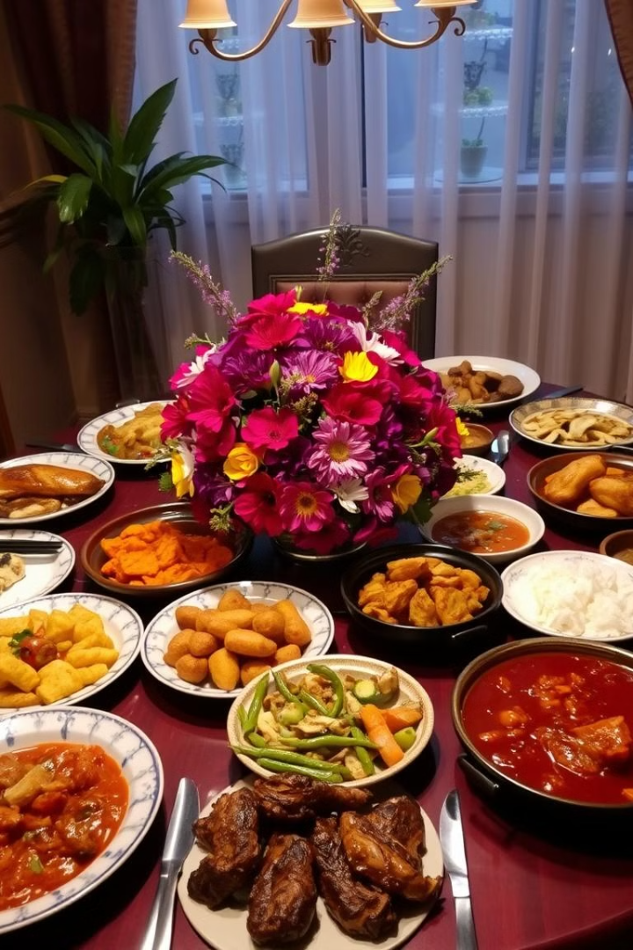
Cuisine Preferences
1
Local Cuisine Matters
Restaurants offering popular local cuisines tend to receive higher customer ratings and more frequent visits.
2
Understanding Preferences
Understanding and aligning with local cuisine preferences can help restaurants attract more customers and increase loyalty.

Slide 12
Price Sensitivity
Regional Variations
Flexible Pricing Strategies
Optimizing Sales
Price sensitivity varies across different regions. Customers in certain areas are more responsive to price changes.
Adjusting offerings to match the purchasing power of the customer base can optimize sales.
Restaurants need to adopt flexible pricing strategies based on regional pricing trends.

Slide 13

Customer Ratings and Experience
Ambiance
Restaurants with better service, a pleasant atmosphere, and varied cuisine offerings tend to score higher in customer satisfaction.
Service Quality
High customer ratings are closely linked to positive factors such as ambiance, service quality, and a diverse menu.
Menu Variety
Higher customer satisfaction leads to better visibility on Zomato and attracts more customers.

Slide 14




Delivery vs Dine-in Preferences
Post-Pandemic Shift
A shift toward food delivery over dine-in experiences was observed, particularly post-pandemic.
Prioritizing Delivery
Restaurants need to prioritize their delivery services, ensuring that food quality is maintained even when delivered.
Seamless Ordering
The ordering experience should be seamless, and partnering with platforms like Zomato can further boost delivery sales.

Slide 15

Location’s Impact on Restaurant Performance
Prime Locations
Higher Customer Visits
Higher Ratings
Strategic Location Selection
Crucial for New Restaurants
Potential for Expanding Delivery Services

Slide 16
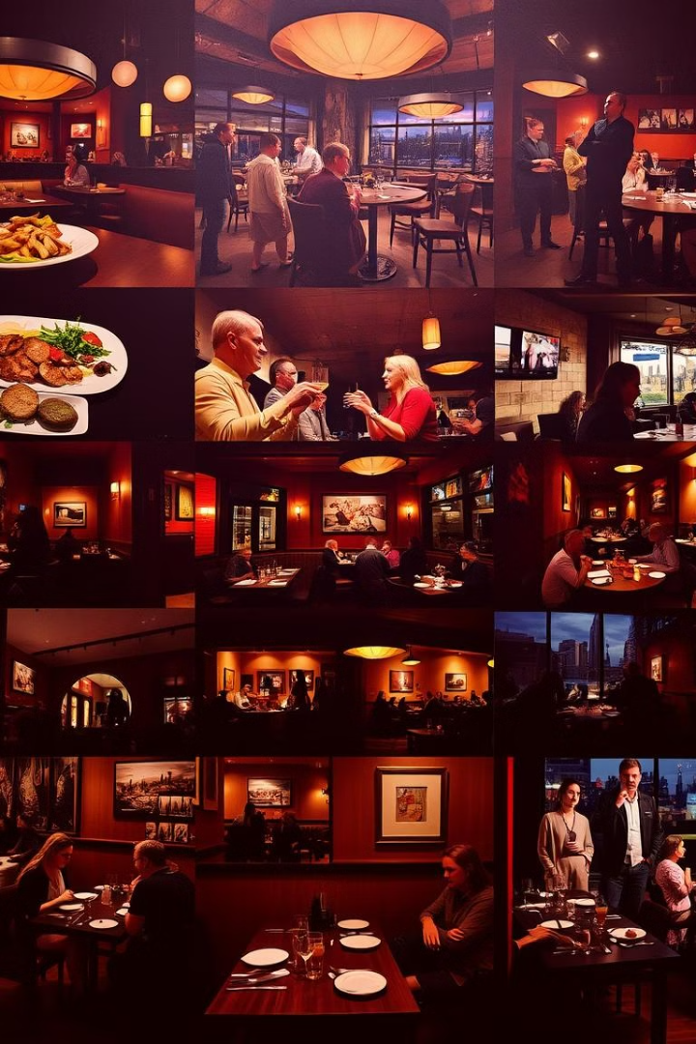



Regional Trends
Location-Based Strategy
Region-specific insights show differing customer preferences and behaviors in various cities.
Menu Customization
For example, while certain regions may prefer fine dining, others may favor casual or fast-food options.
Targeted Offerings
This geographical variation requires restaurants to adopt a location-based strategy for menu offerings and services.

Slide 17
Recommendations:
Enhance Menu Offerings Based on Popular Cuisines:
Restaurants should regularly update their menu to include popular cuisines, as they are closely tied to higher customer satisfaction and ratings.
Optimize Pricing Strategies:
Utilize dynamic pricing models to cater to the varied price sensitivity of different regions. Experiment with special offers or tiered pricing to attract more customers.
Focus on Delivery Services:
With the rise in delivery demand, restaurants should focus on improving their packaging, speed of delivery, and the online ordering experience to align with changing customer behavior.
Leverage Data to Improve Customer Experience:
Use data analytics to continuously monitor customer feedback and ratings. This will help refine restaurant offerings and address pain points that might lower ratings.

Slide 18

Conclusion
Customer preferences, pricing strategies, and location selection are crucial for restaurant success. Zomato's platform provides valuable data insights that can help restaurants make informed decisions and thrive in a competitive market.
Strategic Pricing and Location Planning:
The analysis shows that different regions respond to pricing differently. By tailoring pricing strategies based on local factors, restaurants can boost profits. Additionally, being in a prime location leads to more customer traffic and better reviews.
Delivery vs Dine-in Shift:
Post-pandemic, customers prefer food delivery over dine-in. Restaurants should improve their delivery services, and Zomato can further support this trend with more delivery-focused features.
Importance of Customer Ratings:
Restaurants that enhance ambiance, service, and menu variety receive higher ratings. Better ratings lead to more visibility and customer trust on the Zomato platform.
Data-Driven Decision Making:
Using data tools like MySQL, Excel, Tableau, and Power BI, restaurants can gain insights into pricing, marketing, and operations to make better decisions.
Zomato’s Role:
Zomato serves as a key link between restaurants and customers, providing valuable data that helps restaurants stay competitive.

Slide 19


